Slide 1
Student Management System
Name : Kaushik Mane
Domain : Data Science

Slide 2
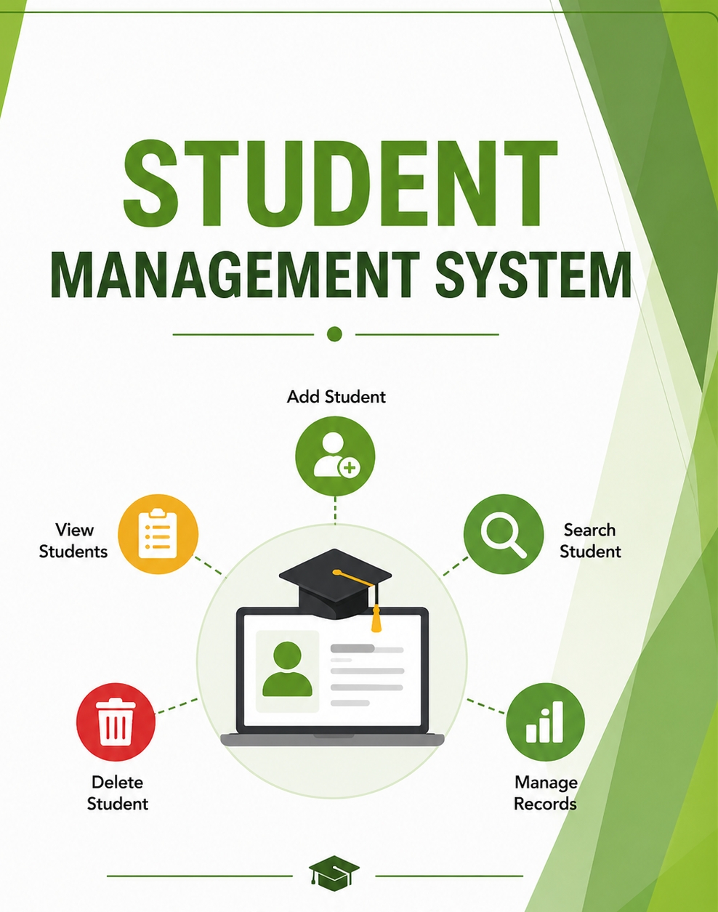
Introduction
A Student Management System is a software application designed to efficiently manage student-related information such as personal details, academic records, and performance data. It simplifies the process of storing, retrieving, and updating student data while reducing manual effort and errors.

Slide 3
Problem Statement
Managing student records manually is time-consuming, error-prone, and difficult to maintain, especially as the number of students increases. Traditional methods lack efficient data organization, quick retrieval, and real-time updates. Therefore, there is a need for a digital solution that can store, manage, and process student information efficiently.

Slide 4
Objective
To design and develop a Student Management System for handling student records digitally
To implement core functionalities such as adding, viewing, searching, and deleting student data
To store and manage data efficiently using JSON file handling
To create an interactive and user-friendly interface using Streamlit

Slide 5
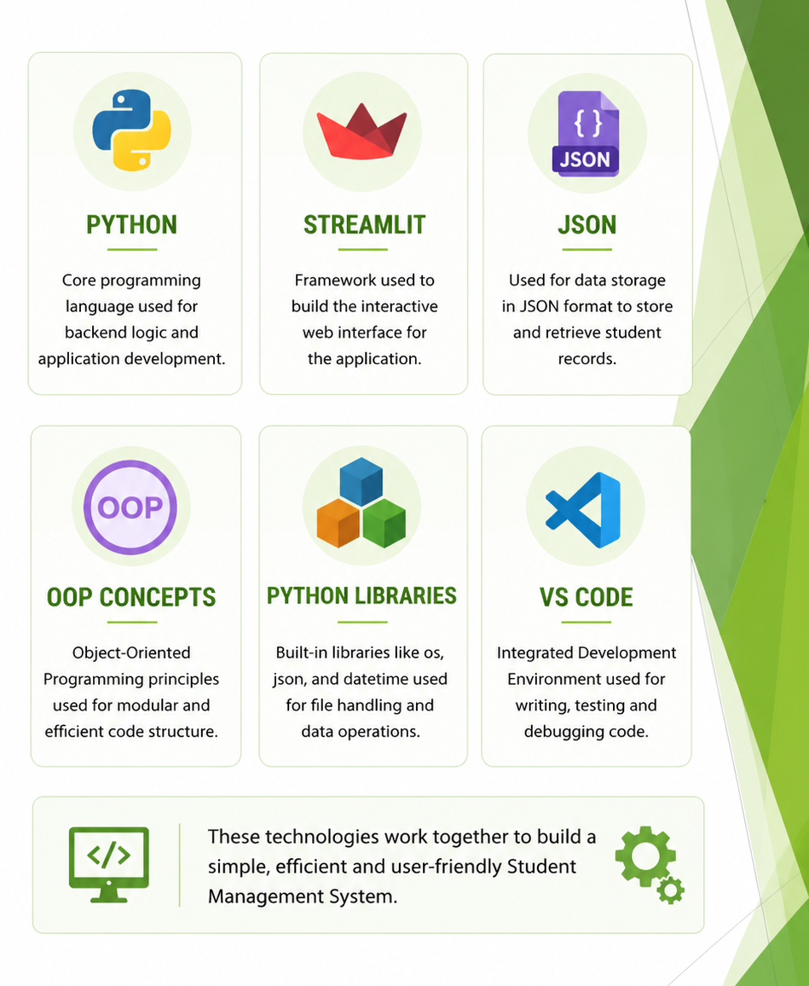
Technologies Used
Python → Core programming
Streamlit → UI development
JSON → Data storage
Pandas → Data handling & CSV export

Slide 6
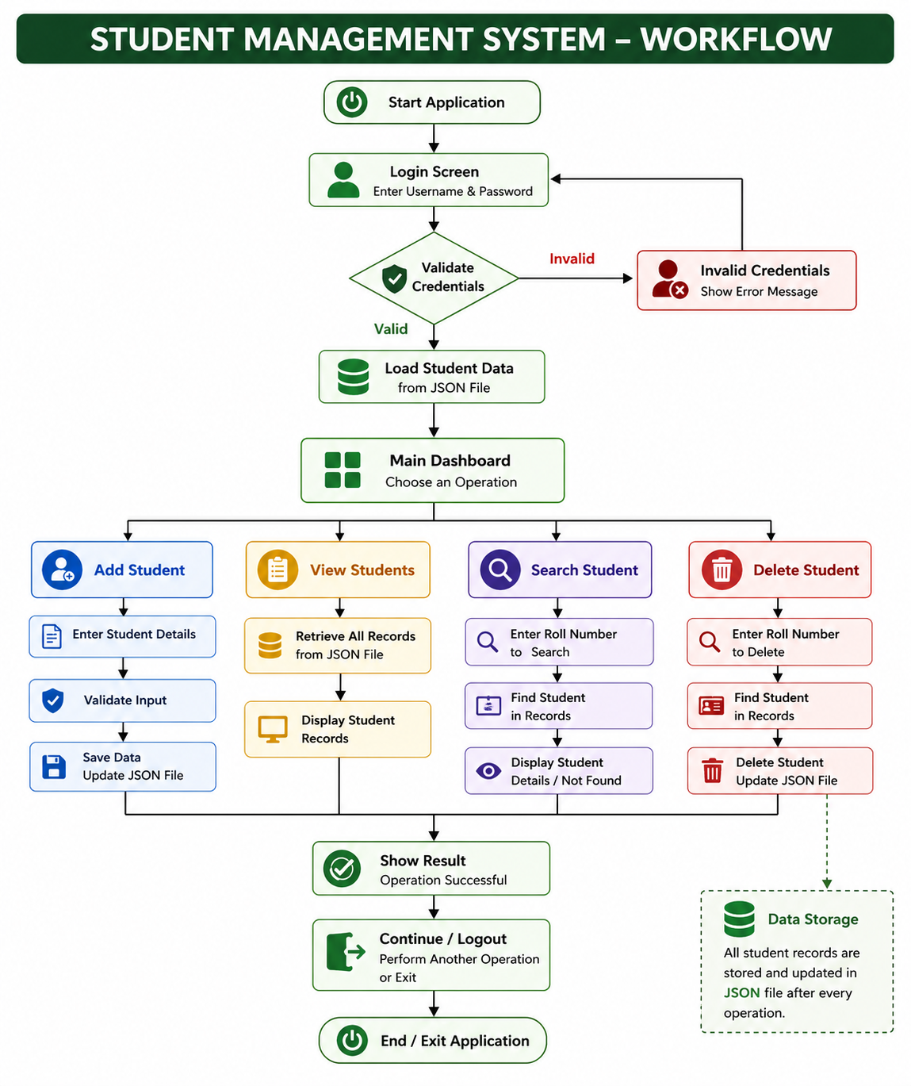
Workflow

Slide 7
Advantages
Improves efficiency by automating student record management
Reduces manual errors in data entry and processing
Provides a user-friendly interface for easy interaction
Supports structured and organized data management
Enhances productivity by saving time and effort

Slide 8
Limitations
Limited to local storage using JSON, which is not suitable for large-scale data
Does not support multiple users or role-based access
No backup or recovery mechanism for data
Limited data validation and error handling
No real-time database integration

Slide 9
Future Scope
To integrate a database system like MySQL or MongoDB for handling large-scale data
To implement multi-user access with role-based authentication (admin, student, teacher)
To develop an update/edit feature for modifying student details
To add data visualization features such as charts and analytics for performance tracking

Slide 10
Conclusion
The Student Management System successfully demonstrates how student data can be managed efficiently using a digital approach. It integrates backend logic with a user-friendly Streamlit interface, enabling operations like adding, viewing, searching, and deleting records with ease. The project highlights the practical application of Python, object-oriented programming, and file handling, while also providing a scalable foundation for future enhancements.

Slide 11
Thank you..!

